Slide 1



Power BI
Download Slide:
https://bit.ly/3jgGZIV
Beginner Advanced

Slide 2

ธัญญ์ธนวัชร์ ปรางค์อมรกุล (ซู)
KMUTT
Bsc. Computer Science
AIS
IT Specialist
THAMMASAT
Msc. Management Information System
DTAC
Asst. Manager, Customer Insight
NIDA
Mini Business Analysis & Data Science
SCB
Head of Analytics Development
DPU (Studying)
Phd. Information Technology
Deloitte
Associate Director,
Financial Advisory, Data Analytics

Slide 3
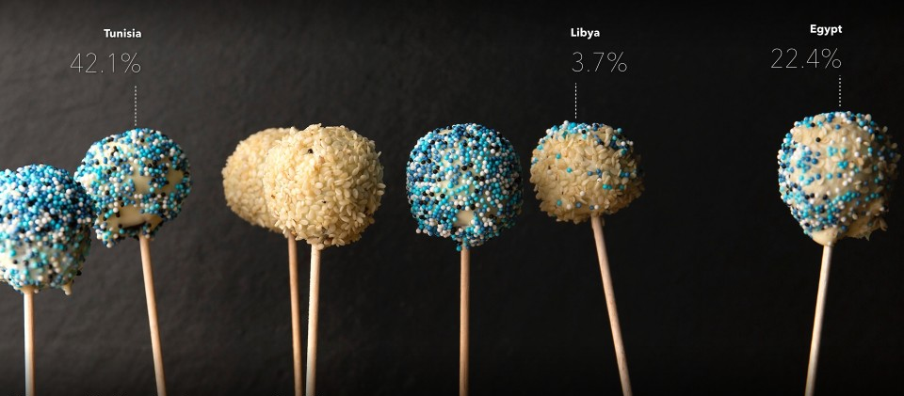
What’s BI?

Slide 4

Clive Humby, 2006

Slide 5
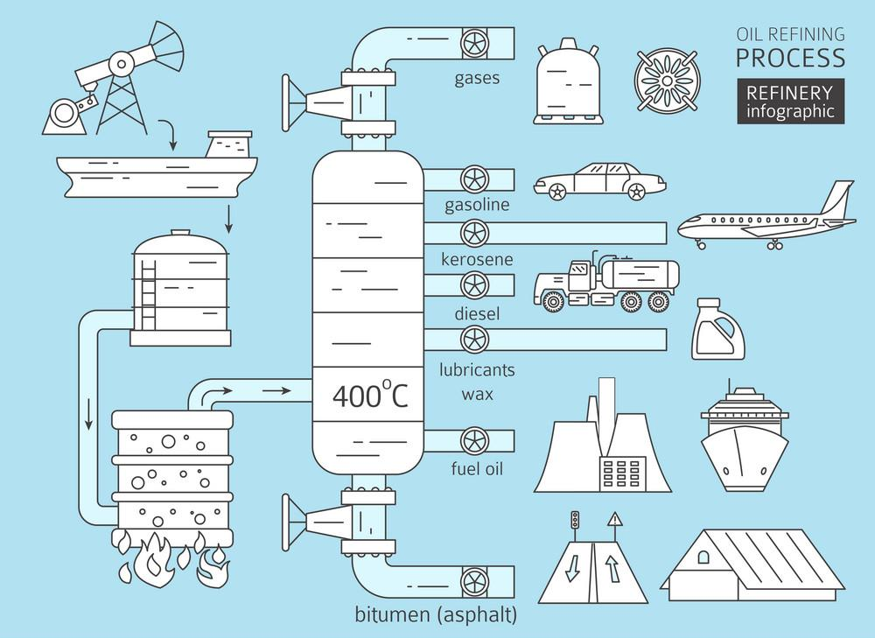

Slide 6
Process
Input
Output
Validation
Cleansing
Transform

Slide 7
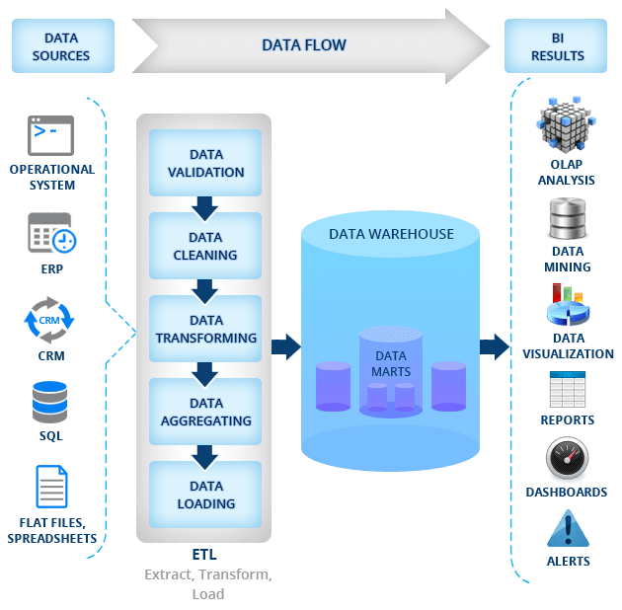

Slide 8
Input
Process
Output

Slide 9

“
Business intelligence (BI)
leverages software and services to transform data into actionable insights that inform an organization’s strategic and tactical business decisions.”
Howard Dresner, Gartner Analyst, 1989

Slide 10

A new generation of BI
3rd wave End user BI
Analytics, Action, Automation
Everyone
2nd wave Self-service BI
Why did it happen?
Analyst to end user
1st wave Technical BI
What happened report?
IT to end user

Slide 11
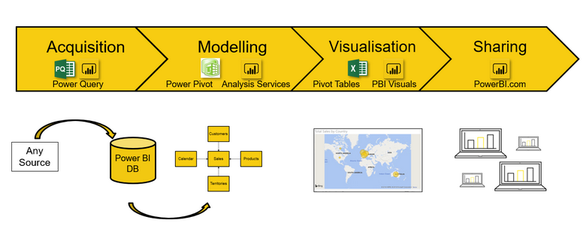
Step of Power BI
ETL
REF: Excelerator BI

Slide 12
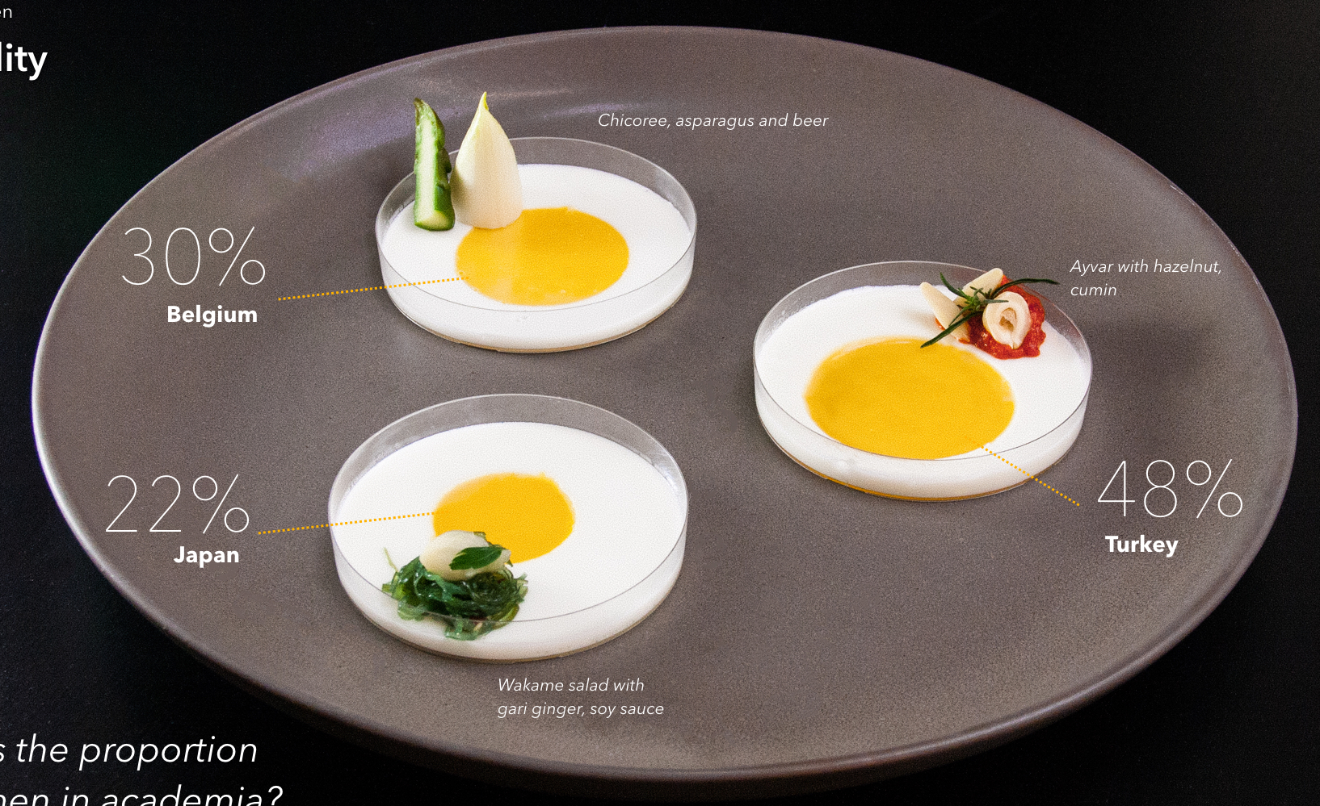
Why Visualize?

Slide 13
6 | 9 | 6
6 | 6 | 9
9 | 6 | 8
Where’s 9?

Slide 14
6 | 9 | 6
6 | 6 | 9
9 | 6 | 8
Where’s 9?

Slide 15
6 | 9 | 6 | 6 | 6 | 8 | 9 | 8 | 8 | 6 | 9 | 6 | 6 | 8 | 9 | 9 | 8 | 6 | 6 | 6
6 | 6 | 9 | 8 | 8 | 6 | 6 | 9 | 6 | 8 | 6 | 6 | 9 | 9 | 8 | 6 | 6 | 8 | 9 | 8
9 | 6 | 8 | 6 | 8 | 6 | 6 | 6 | 6 | 6 | 8 | 6 | 6 | 8 | 6 | 8 | 8 | 8 | 8 | 8
6 | 8 | 6 | 8 | 8 | 8 | 8 | 8 | 6 | 6 | 6 | 8 | 8 | 8 | 8 | 6 | 8 | 6 | 8 | 6
6 | 8 | 8 | 8 | 6 | 8 | 6 | 6 | 6 | 8 | 8 | 6 | 8 | 8 | 6 | 6 | 6 | 8 | 6 | 8
8 | 8 | 8 | 9 | 8 | 8 | 8 | 8 | 8 | 8 | 8 | 8 | 8 | 8 | 8 | 9 | 8 | 8 | 8 | 8
6 | 8 | 6 | 8 | 6 | 8 | 6 | 6 | 8 | 8 | 6 | 8 | 6 | 8 | 6 | 8 | 8 | 8 | 8 | 6
8 | 8 | 8 | 8 | 8 | 8 | 8 | 8 | 6 | 6 | 8 | 8 | 8 | 8 | 8 | 6 | 6 | 8 | 6 | 8
8 | 8 | 8 | 8 | 9 | 8 | 8 | 8 | 6 | 6 | 9 | 6 | 8 | 8 | 8 | 6 | 8 | 8 | 6 | 8
9 | 8 | 6 | 8 | 8 | 8 | 6 | 8 | 8 | 6 | 8 | 8 | 6 | 6 | 8 | 6 | 8 | 6 | 6 | 6
8 | 8 | 6 | 6 | 6 | 8 | 9 | 8 | 6 | 6 | 8 | 8 | 6 | 8 | 8 | 6 | 8 | 8 | 6 | 8
9 | 8 | 8 | 8 | 6 | 8 | 8 | 8 | 6 | 8 | 6 | 8 | 6 | 6 | 8 | 6 | 6 | 6 | 8 | 8
8 | 8 | 8 | 9 | 8 | 8 | 6 | 8 | 8 | 8 | 8 | 8 | 6 | 8 | 6 | 8 | 8 | 8 | 8 | 6
8 | 8 | 6 | 8 | 6 | 6 | 6 | 8 | 8 | 8 | 8 | 9 | 8 | 8 | 6 | 8 | 8 | 6 | 8 | 6
8 | 8 | 6 | 8 | 8 | 8 | 9 | 8 | 6 | 8 | 8 | 8 | 8 | 8 | 6 | 6 | 8 | 8 | 8 | 6
8 | 8 | 8 | 8 | 8 | 8 | 8 | 8 | 6 | 6 | 8 | 8 | 8 | 8 | 8 | 6 | 8 | 6 | 8 | 8
9 | 8 | 6 | 8 | 6 | 8 | 6 | 6 | 8 | 6 | 6 | 8 | 6 | 8 | 6 | 6 | 8 | 6 | 8 | 6
8 | 8 | 8 | 8 | 8 | 9 | 6 | 8 | 8 | 6 | 8 | 8 | 8 | 8 | 8 | 8 | 8 | 6 | 8 | 8
8 | 6 | 6 | 6 | 6 | 8 | 8 | 6 | 6 | 8 | 8 | 6 | 6 | 6 | 8 | 9 | 8 | 8 | 6 | 8
8 | 8 | 8 | 9 | 6 | 6 | 6 | 8 | 6 | 8 | 8 | 8 | 8 | 8 | 9 | 6 | 6 | 6 | 8 | 8
Where’s 9?

Slide 16
6 | 6 | 6 | 6 | 6 | 8 | 9 | 8 | 8 | 6 | 9 | 6 | 6 | 8 | 6 | 9 | 8 | 6 | 6 | 6
6 | 6 | 9 | 8 | 8 | 6 | 6 | 6 | 6 | 8 | 6 | 6 | 9 | 6 | 8 | 6 | 6 | 8 | 9 | 8
9 | 6 | 8 | 6 | 8 | 6 | 6 | 6 | 6 | 6 | 8 | 6 | 6 | 8 | 6 | 8 | 8 | 8 | 8 | 8
6 | 8 | 6 | 8 | 8 | 8 | 8 | 8 | 6 | 6 | 6 | 8 | 8 | 8 | 8 | 6 | 8 | 6 | 8 | 6
6 | 8 | 8 | 8 | 6 | 8 | 6 | 6 | 6 | 8 | 8 | 6 | 8 | 8 | 6 | 6 | 6 | 8 | 6 | 8
8 | 8 | 8 | 9 | 8 | 8 | 8 | 8 | 8 | 8 | 8 | 8 | 8 | 8 | 8 | 9 | 8 | 8 | 8 | 8
6 | 8 | 6 | 8 | 6 | 8 | 6 | 6 | 8 | 8 | 6 | 8 | 6 | 8 | 6 | 8 | 8 | 8 | 8 | 6
8 | 8 | 8 | 8 | 8 | 8 | 8 | 8 | 6 | 6 | 8 | 8 | 8 | 8 | 8 | 6 | 6 | 8 | 6 | 8
8 | 8 | 8 | 8 | 9 | 8 | 8 | 8 | 6 | 6 | 9 | 6 | 8 | 8 | 8 | 6 | 8 | 8 | 6 | 8
9 | 8 | 6 | 8 | 8 | 8 | 6 | 8 | 8 | 6 | 8 | 8 | 6 | 6 | 8 | 6 | 8 | 6 | 6 | 6
8 | 8 | 6 | 6 | 6 | 8 | 9 | 8 | 6 | 6 | 8 | 8 | 6 | 8 | 8 | 6 | 8 | 8 | 6 | 8
9 | 8 | 8 | 8 | 6 | 8 | 8 | 8 | 6 | 8 | 6 | 8 | 6 | 6 | 8 | 6 | 6 | 6 | 8 | 8
8 | 8 | 8 | 9 | 8 | 8 | 6 | 8 | 8 | 8 | 8 | 8 | 6 | 8 | 6 | 8 | 8 | 8 | 8 | 6
8 | 8 | 6 | 8 | 6 | 6 | 6 | 8 | 8 | 8 | 8 | 9 | 8 | 8 | 6 | 8 | 8 | 6 | 8 | 6
8 | 8 | 6 | 8 | 8 | 8 | 9 | 8 | 6 | 8 | 8 | 8 | 8 | 8 | 6 | 6 | 8 | 8 | 8 | 6
8 | 8 | 8 | 8 | 8 | 8 | 8 | 8 | 6 | 6 | 8 | 8 | 8 | 8 | 8 | 6 | 8 | 6 | 8 | 8
9 | 8 | 6 | 8 | 6 | 8 | 6 | 6 | 8 | 6 | 6 | 8 | 6 | 8 | 6 | 6 | 8 | 6 | 8 | 6
8 | 8 | 8 | 8 | 8 | 9 | 6 | 8 | 8 | 6 | 8 | 8 | 8 | 8 | 8 | 8 | 8 | 6 | 8 | 8
8 | 6 | 6 | 6 | 6 | 8 | 8 | 6 | 6 | 8 | 8 | 6 | 6 | 6 | 8 | 9 | 8 | 8 | 6 | 8
8 | 8 | 8 | 9 | 6 | 6 | 6 | 8 | 6 | 8 | 8 | 8 | 8 | 8 | 9 | 6 | 6 | 6 | 8 | 8
Where’s 9?

Slide 17
6 | 6 | 6 | 6 | 6 | 6 | 6 | 6 | 6 | 6 | 6 | 6 | 6 | 6 | 6 | 6 | 6 | 6 | 6 | 6
6 | 6 | 6 | 6 | 6 | 6 | 6 | 6 | 6 | 6 | 6 | 6 | 6 | 6 | 6 | 6 | 6 | 6 | 6 | 6
6 | 6 | 6 | 6 | 6 | 6 | 6 | 6 | 6 | 6 | 6 | 6 | 6 | 6 | 6 | 6 | 6 | 6 | 6 | 6
6 | 6 | 6 | 6 | 6 | 6 | 6 | 6 | 6 | 6 | 6 | 6 | 6 | 6 | 6 | 6 | 6 | 6 | 6 | 6
6 | 6 | 6 | 6 | 6 | 6 | 6 | 6 | 6 | 6 | 6 | 6 | 6 | 6 | 6 | 6 | 6 | 6 | 6 | 6
6 | 6 | 6 | 6 | 6 | 6 | 6 | 6 | 6 | 6 | 6 | 6 | 6 | 6 | 6 | 6 | 6 | 6 | 6 | 6
6 | 6 | 6 | 6 | 6 | 6 | 6 | 6 | 6 | 6 | 6 | 6 | 6 | 6 | 6 | 6 | 6 | 6 | 6 | 6
6 | 6 | 6 | 6 | 6 | 6 | 6 | 6 | 6 | 6 | 6 | 6 | 6 | 6 | 6 | 6 | 6 | 6 | 8 | 8
8 | 8 | 8 | 8 | 8 | 8 | 8 | 8 | 8 | 8 | 8 | 8 | 8 | 8 | 8 | 8 | 8 | 8 | 8 | 8
8 | 8 | 8 | 8 | 8 | 8 | 8 | 8 | 8 | 8 | 8 | 8 | 8 | 8 | 8 | 8 | 8 | 8 | 8 | 8
8 | 8 | 8 | 8 | 8 | 8 | 8 | 8 | 8 | 8 | 8 | 8 | 8 | 8 | 8 | 8 | 8 | 8 | 8 | 8
8 | 8 | 8 | 8 | 8 | 8 | 8 | 8 | 8 | 8 | 8 | 8 | 8 | 8 | 8 | 8 | 8 | 8 | 8 | 8
8 | 8 | 8 | 8 | 8 | 8 | 8 | 8 | 8 | 8 | 8 | 8 | 8 | 8 | 8 | 8 | 8 | 8 | 8 | 8
8 | 8 | 8 | 8 | 8 | 8 | 8 | 8 | 8 | 8 | 8 | 8 | 8 | 8 | 8 | 8 | 8 | 8 | 8 | 8
8 | 8 | 8 | 8 | 8 | 8 | 8 | 8 | 8 | 8 | 8 | 8 | 8 | 8 | 8 | 8 | 8 | 8 | 8 | 8
8 | 8 | 8 | 8 | 8 | 8 | 8 | 8 | 8 | 8 | 8 | 8 | 8 | 8 | 8 | 8 | 8 | 8 | 8 | 8
8 | 8 | 8 | 8 | 8 | 8 | 8 | 8 | 8 | 8 | 8 | 8 | 8 | 8 | 8 | 8 | 8 | 8 | 8 | 8
8 | 8 | 8 | 8 | 8 | 8 | 8 | 8 | 8 | 8 | 8 | 8 | 8 | 8 | 8 | 8 | 8 | 8 | 8 | 8
8 | 8 | 8 | 8 | 8 | 8 | 8 | 8 | 8 | 8 | 8 | 8 | 8 | 8 | 8 | 8 | 8 | 8 | 9 | 9
9 | 9 | 9 | 9 | 9 | 9 | 9 | 9 | 9 | 9 | 9 | 9 | 9 | 9 | 9 | 9 | 9 | 9 | 9 | 9
Where’s 9?

Slide 18
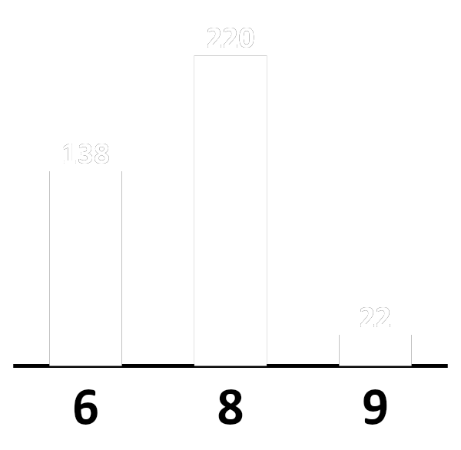
Where’s 9?

Slide 19
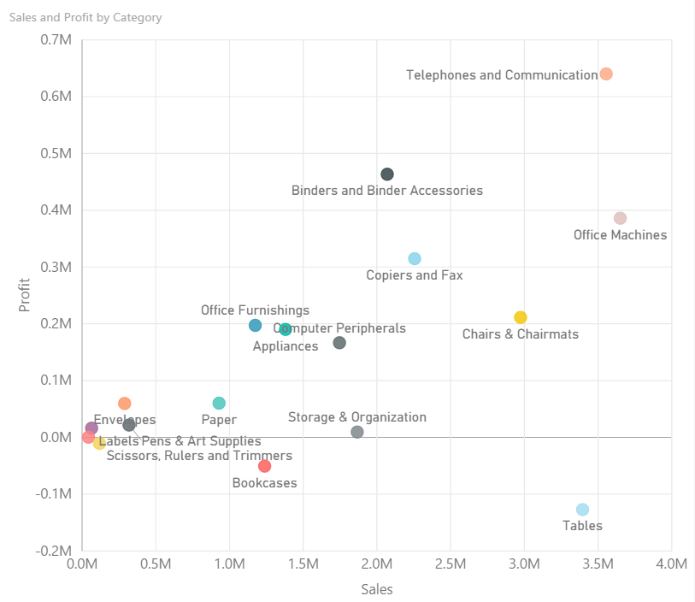
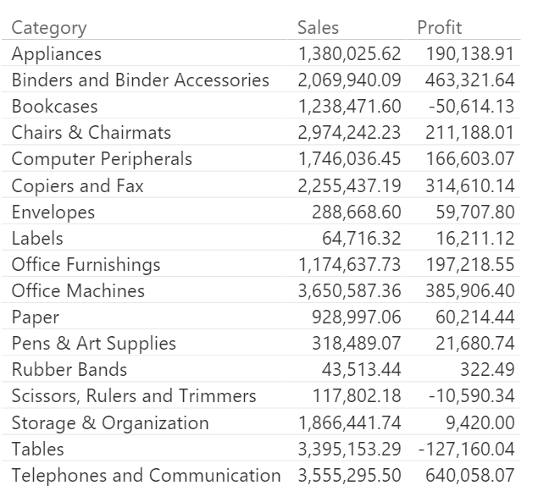
Why visualization?

Slide 20
Data Types
Quantitative - Anything that has exact numbers or measurement.
For example, Effort in points: 0, 1, 2, 3, 5, 8, 13. Duration in days: 1, 4, 666.
Qualitative / Ordered - Anything that can be compared and ordered.
User Story Priority: Must Have, Great, Good, Not Sure. Days: Mon, Tue, Wed, Thu, Fri, Sat, Sun.
Categorical - Everything else.
Entity types: Bugs, Stories, Features, Test Cases. Fruits: Apples, Oranges, Plums.

Slide 21
Dimension &
Measurement
Dimension
Measurement
Fact Row 🡪
Fact Row 🡪
Fact Row 🡪
.
.
.

Slide 22
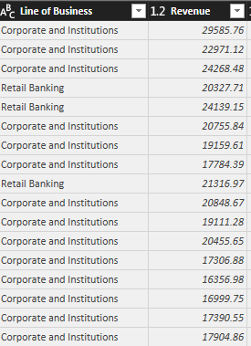
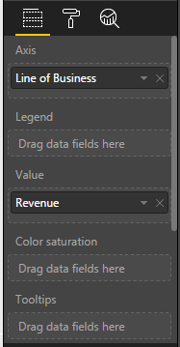
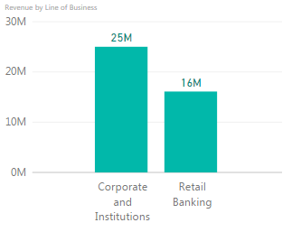
Dimension & Measurement
Dimension
Measurement
Measurement
Dimension
Measurement
Dimension

Slide 23
Acquisition
Data Source
Power Query
Data types & Category
Data Extracting (Split, Extract, Merge, Join, etc.)
Data Transformation (Transpose, Pivot, etc.)
Data Cleansing (Remove dup, filter, replace, etc.)
Data Summarization (Grouping, count rows)
Column Calculation (Custom, conditional column)
DAX
Calculate column
Calculate measure
Syntax & Operator
Aggregate function
Counting function
Logical function (If, Switch)
Text function
Date time function
Calendar
Filter function
Visualization
Dashboard Design
Types of Visualization
Data Hierarchy (Drill down, up)
Condition Formatting
Advance filtering (Top-N)
Slicer
Advanced Analytics (trendline, forecast)
Drill through
Visual Interaction
Data Model
Data Model / Schema
Table Relationship
Database Normalization
Sharing
Publish
Role Management
Power BI Services
Schedule Refresh
Mobile view

Slide 24
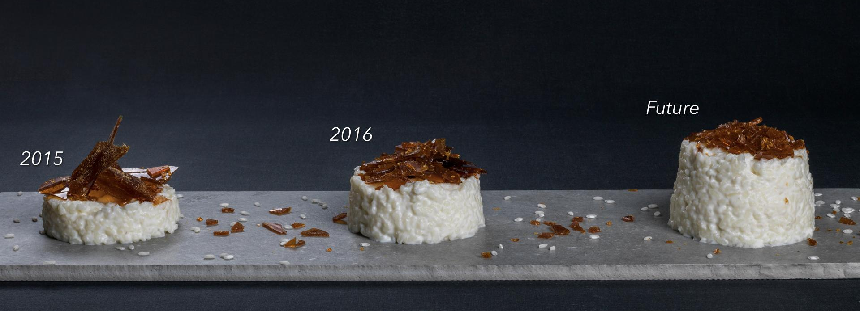
Dashboard Design
REF: UXPlanet.org

Slide 25
1. Define the purpose

Slide 26
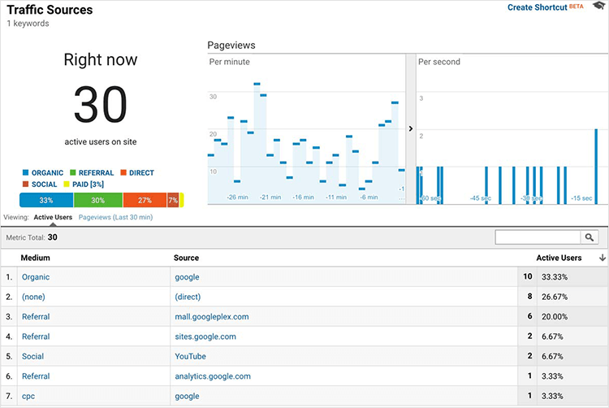
Operational Dashboard

Slide 27
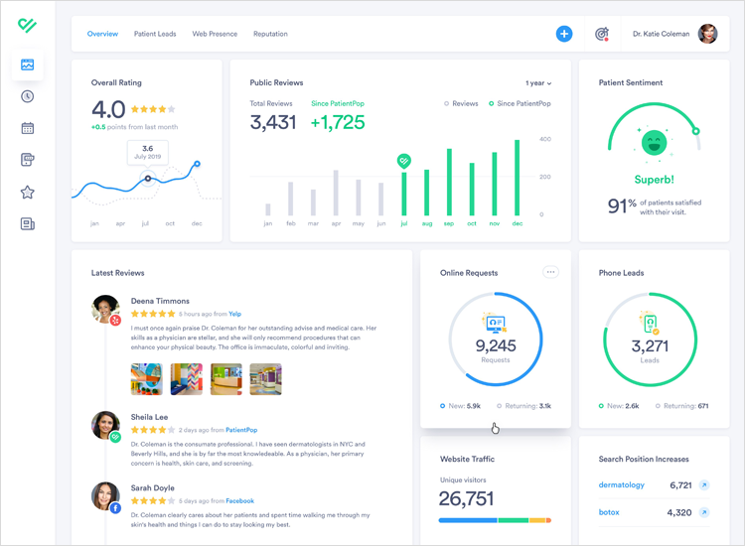
Analytics Dashboard

Slide 28
2. Chose the right visual

Slide 29
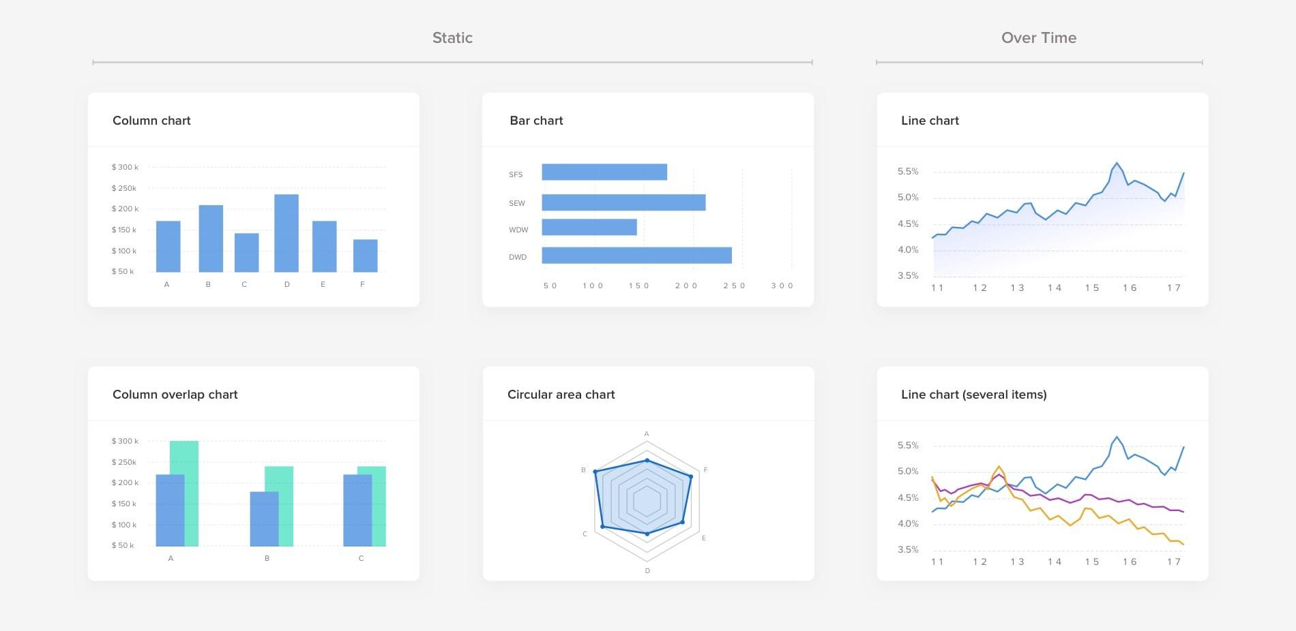
Compare

Slide 30
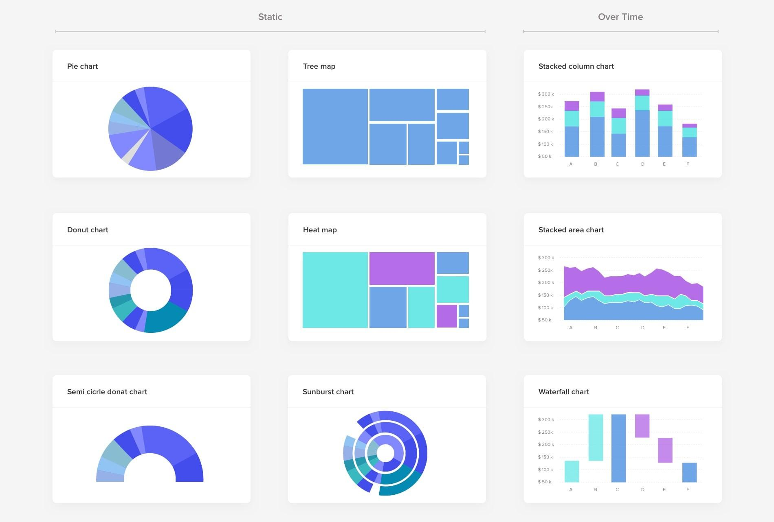
See parts of the whole

Slide 31
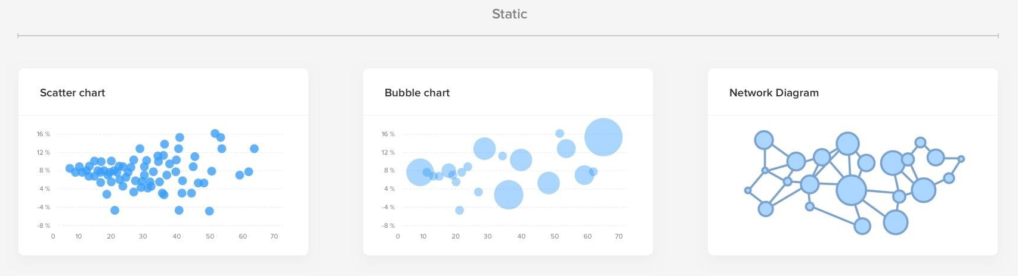
See relationship

Slide 32
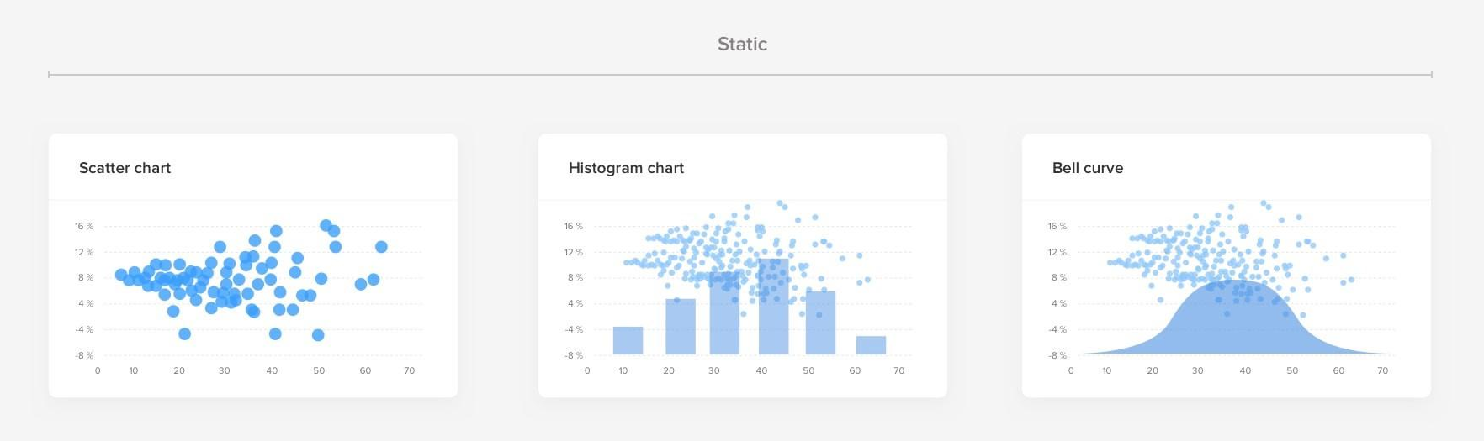
Distribution

Slide 33
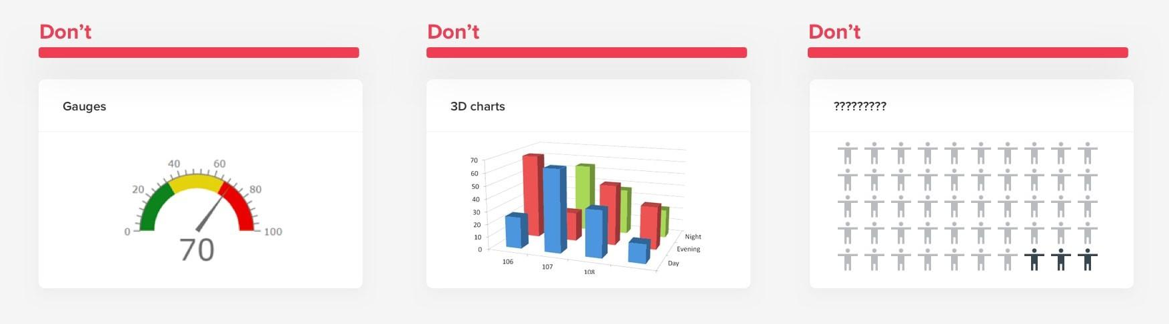
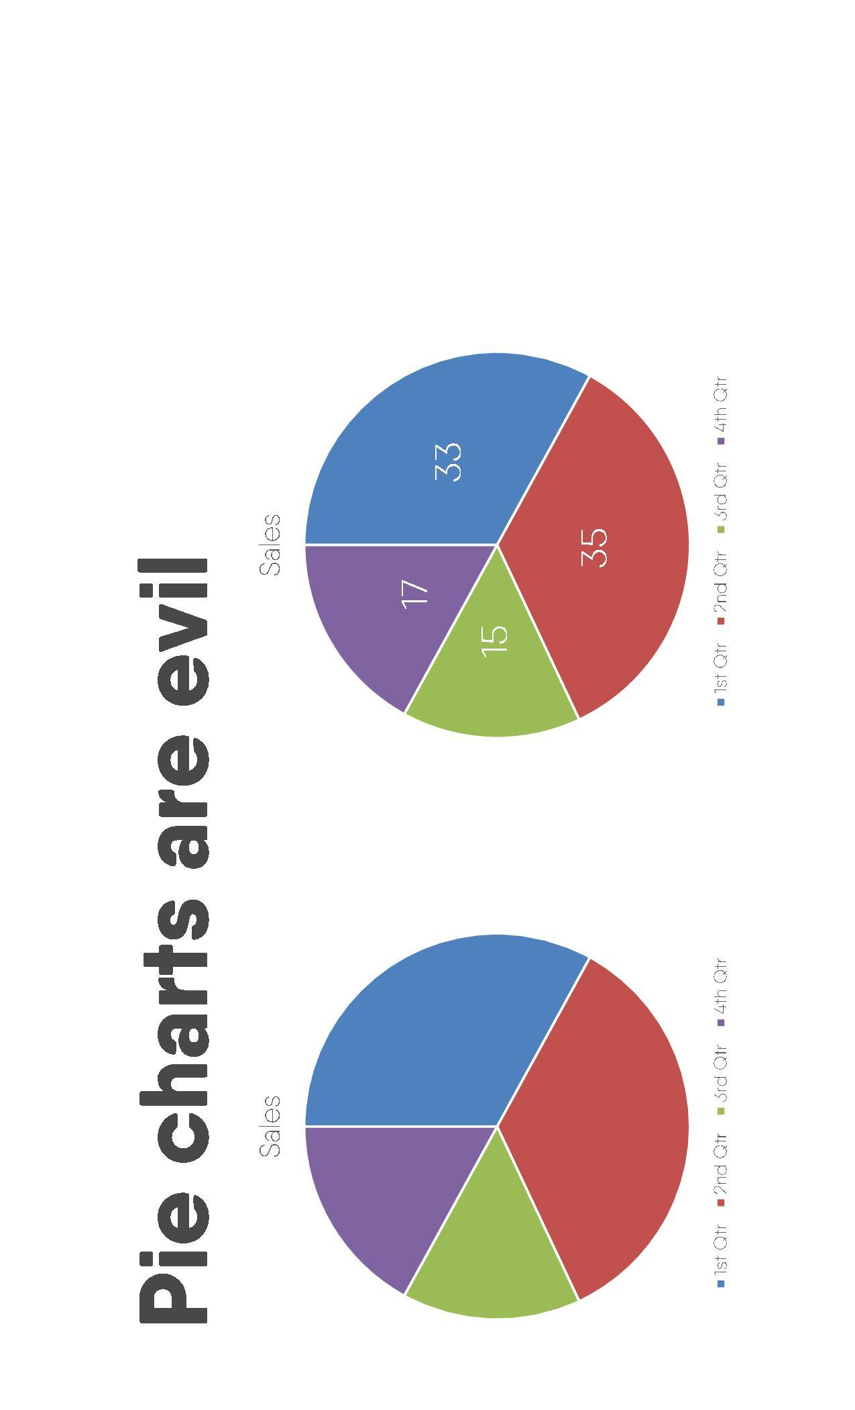
Don’t

Slide 34
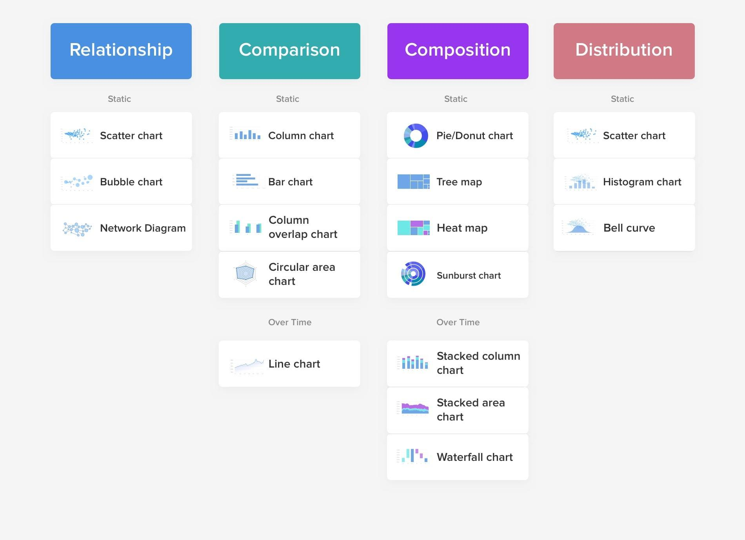

Slide 35
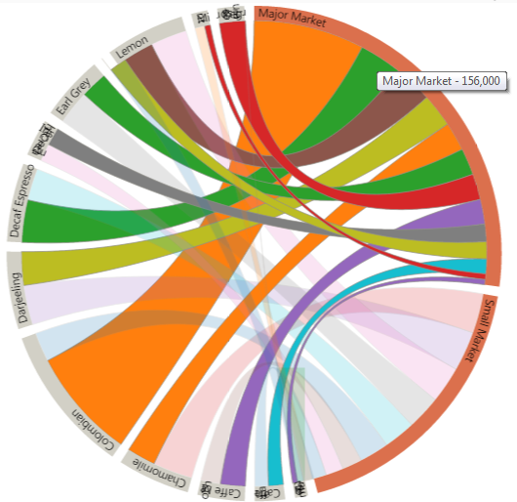
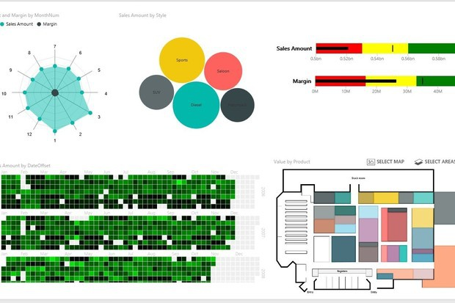
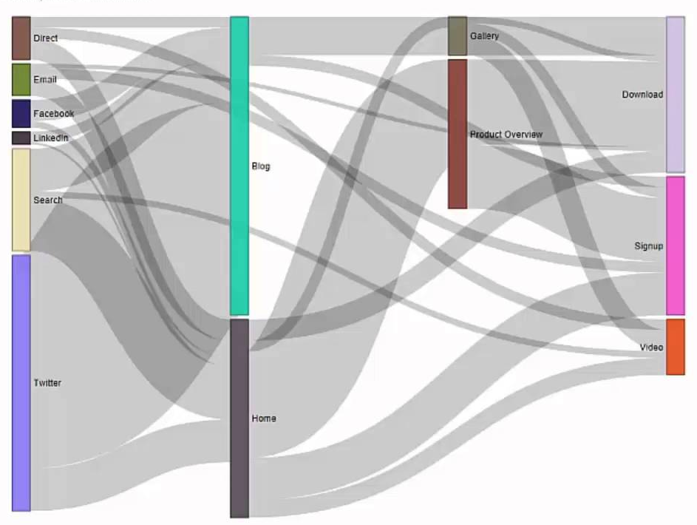

Slide 36
3. Clear and consistent naming conversions, data formatting, truncate large values.

Slide 37
4. Define the layout and flow, prioritize.

Slide 38
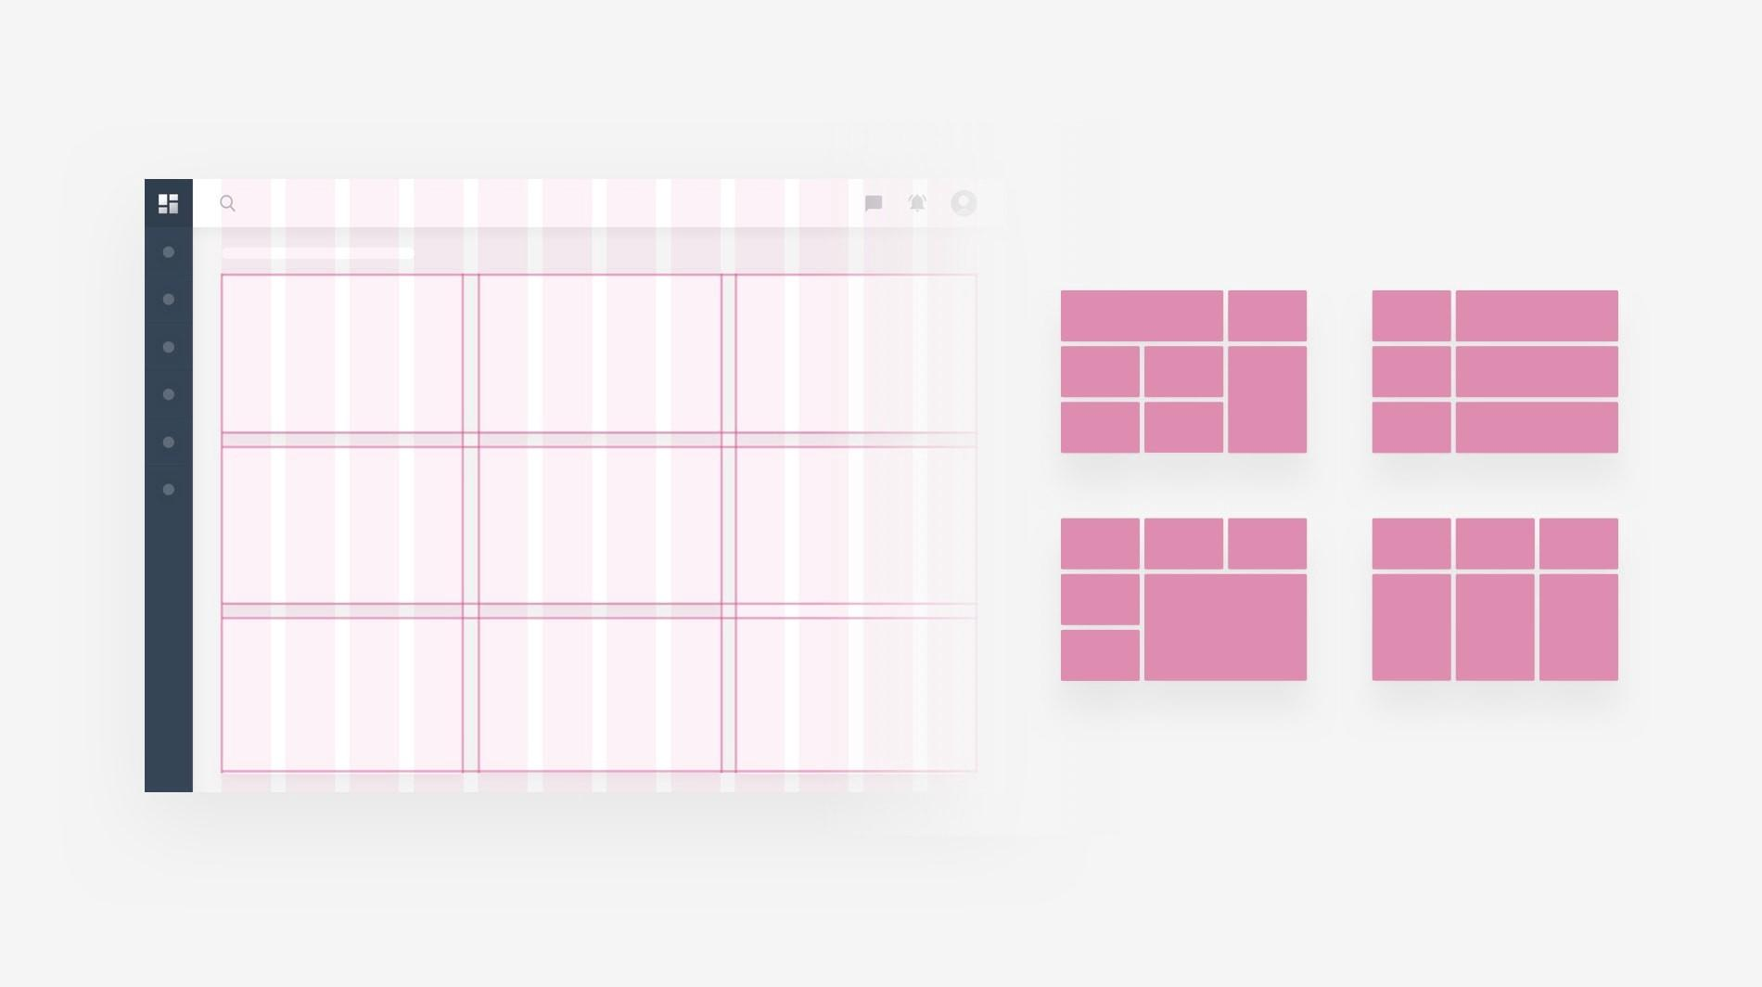
Follow layout

Slide 39
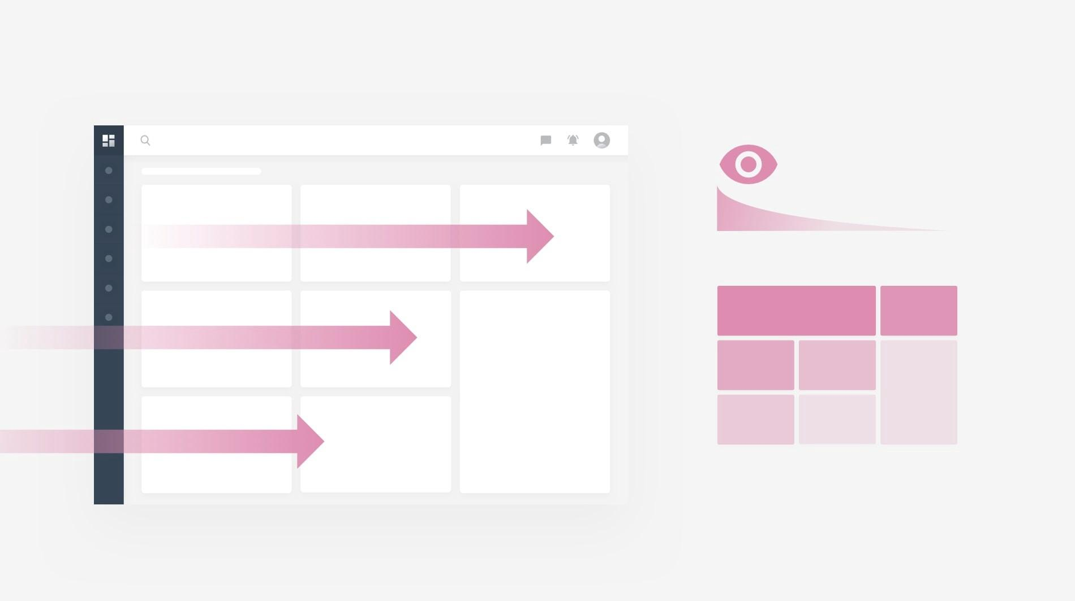
Eye movement

Slide 40
5. Design dashboard

Slide 41
Master-Child design
Master
navigate child
Child
Child
Child
Child
Child

Slide 42
Multi-action design

Slide 43
Navigation design
Navigation
Child
Child
Child
Child
Child

Slide 44
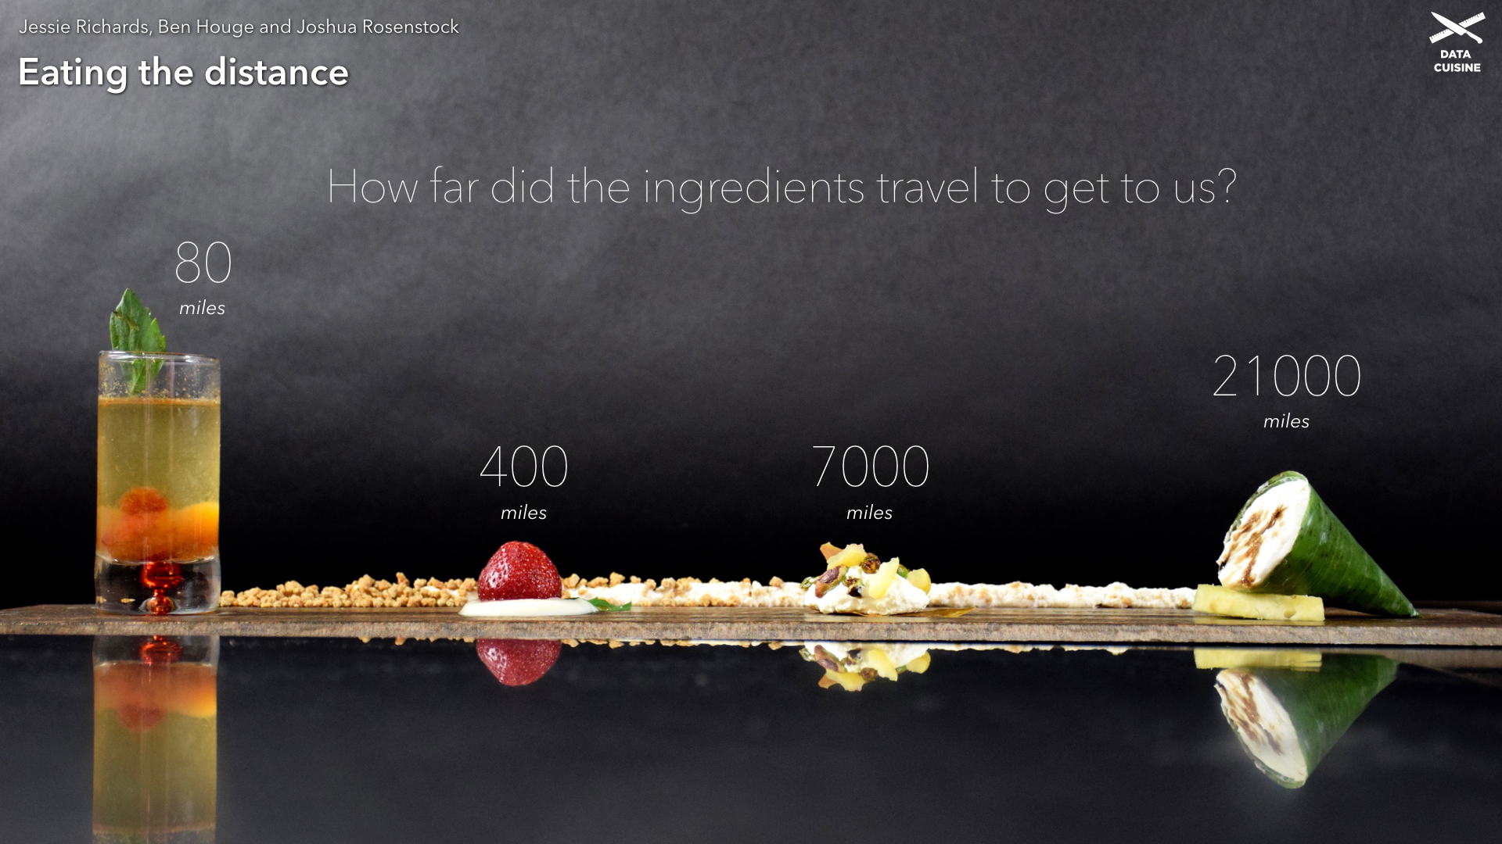
Q&A

Slide 45
Get Data
https://bit.ly/3wWswJV

